Slide 1
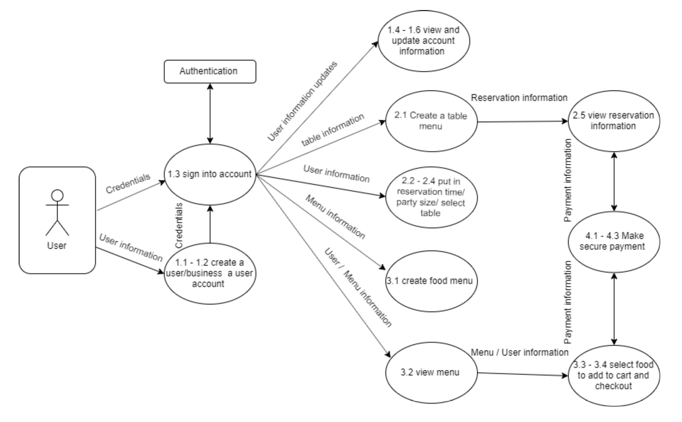
Super Servoli Systems - Data-flow Diagram (logical)

